Slide 1
Performance Measures Alignment Subcommittee Kickoff Meeting
Kentucky Core
Healthcare
Measures Set

Slide 2
WELCOME

Slide 3
Welcoming Remarks
Vickie Glisson
Cabinet Secretary
KY Cabinet for Health & Family Services
Notes:
Presentation layout

Slide 4
Welcoming Remarks
Randa Deaton, MA
Corporate Director
UAW/Ford Community Healthcare Initiative Co-Executive Director
Kentuckiana Health Collaborative
Gilbert C. Liu, MD, MS
Medical Director
Cabinet for Health and Family Services
Department for Medicaid Services
Office of the Commissioner
Notes:
PMAC Co-Chair Welcoming Remarks?

Slide 5
Today’s Agenda
Welcome and Opening Remarks
Subcommittee Chairs’ Remarks and Subcommittee Member Role Call
Project Goals, Summary
PMAC Portal and Packet
Q&A
Notes:
Presentation layout

Slide 6
Subcommittee Chairs
& Roll Call

Slide 7
SUBCOMMITTEE CHAIRS’ REMARKS
PEDIATRIC CARE SUBCOMMITTEE
Julia Richerson, MD
Pediatrician
Family Health Centers
CHRONIC AND ACUTE CARE SUBCOMMITTEE
Trudi Matthews, MA
Managing Director
KY Regional Extension Center
PREVENTIVE CARE SUBCOMMITTEE
Kayla Rose
Dir. of Practice Improvement Programs
Kentucky Primary Care Association
BEHAVIORAL HEALTH SUBCOMMITTEE
Sarah Moyer, MD, MPH
Director
Louisville Metro Public Health and Wellness
Notes:
Presentation layout

Slide 8
Subcommittee Roll Call
When introducing yourself, please include:
Representative name and role within organization
What would you like to see this core measurement set accomplish?
Notes:
Presentation layout

Slide 9
Preventive Care
Notes:
Presentation layout

Slide 10
Pediatric Care
Notes:
Presentation layout

Slide 11
Chronic & Acute Care
Notes:
Presentation layout

Slide 12
Behavioral Health
Notes:
Presentation layout

Slide 13
Project Summary/Goals

Slide 14
Project Summary
Stephanie Clouser
Data Scientist
Kentuckiana Health Collaborative
Notes:
Presentation layout

Slide 15
Kentucky Performance Measures
Alignment Committee (PMAC)
Public-private partnership between KHC and Kentucky Department for Medicaid Services to develop a Kentucky Core Healthcare Measures Set for primary care and pediatric providers.
Four subcommittees:
Preventive
Chronic & Acute
Pediatric
Behavioral Health
Notes:
Presentation layout

Slide 16
Project Goal
The goals of the Kentucky Core Healthcare Measure Set (KCHMS) are to establish broadly agreed upon core quality measures that:
Improve the quality and value of care
Reduce provider reporting complexity
Align Kentucky’s healthcare organizations
Notes:
Presentation layout

Slide 17
Subcommittees’ Role
Become familiar with the list of measures under consideration as part of the KY Core Healthcare Measures Set
Measures identified as leading indicators not currently in the list under consideration can be added with subcommittee consensus
Identify the leading indicators for primary care and pediatric providers that support the current clinical guidelines
Consider the feasibility of provider reporting capability throughout Kentucky in making recommendations
Measures identified as leading indicators but are not yet feasible to report can go into “future” measures for consideration
Subcommittee recommendations will go to PMAC for a final decision
Notes:
Presentation layout

Slide 18
PMAC PORTAL & PACKET

Slide 19
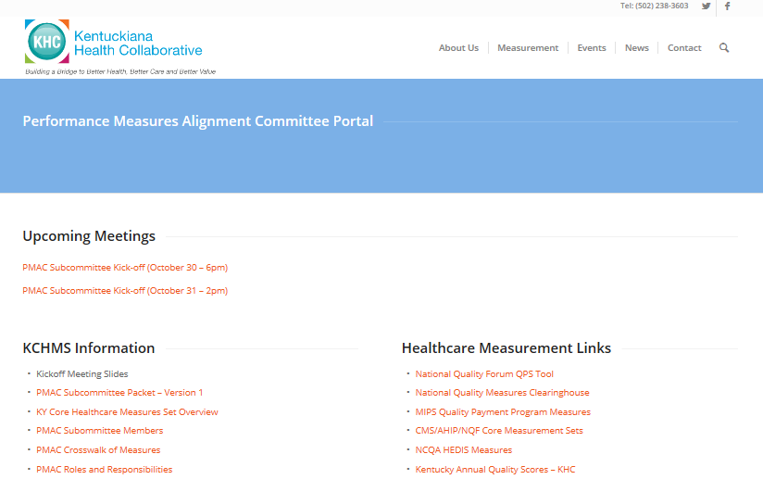
PMAC PORTAL
KHCollaborative.org/pmacportal
Password: kchms
Notes:
Presentation layout

Slide 20
Subcommittee Packet – Version 1
Welcome Letter
Rosters
KY Core Healthcare Measures Set Overview
PMAC Committee Agreement
Timeline
Crosswalk
Measure Selection Criteria
Focus Area Measure Information:
Preventive Measures
Pediatric Measures
Chronic and Acute Measures
Behavioral Health Measures
Appendix
Notes:
Presentation layout

Slide 21
Selection Criteria
The core measures will be selected based on currently available reporting capabilities and selection criteria. Below are the criteria for selecting measures to be selected as part of the common measurement set:
The measure set is of manageable size (to be determined by committee)
Measures are based on readily available data in KY (we must identify the data source), such as HEDIS measures.
Preference given to nationally-vetted measures (e.g., NQF-endorsed) and aligned to Medicaid and MIPS measurement sets.
Each measure should be valid and reliable, and produce sufficient numerator and denominator size to support credible public reporting.
Measures target issues where we believe there is significant potential to improve health system performance in a way that will positively impact health outcomes and reduce costs without unintended harm.
If the unit of analysis includes health care providers, the measure should be amenable to influence by providers.
The measure set is useable by multiple parties (e.g., payers, provider organizations, public health, communities, and/or policy-makers).
Notes:
Presentation layout

Slide 22
Crosswalk
Notes:
Presentation layout

Slide 23
Crosswalk
Overview of Crosswalk
Notes:
Presentation layout

Slide 24
Timeline
Target Date | Activity
2017
August 22 | Measurement Alignment Discovery Meeting
September 7 | PMAC Planning Meeting
September | Subcommittees Formed
September 21 | Secretary Glisson Announces Measurement Alignment Work
October 30, 31 | Subcommittee Orientation Meeting and Kickoff
November | First Subcommittee Meeting Convened
2018
March | Complete Subcommittee Meetings
April | Subcommittee Chairs Present Recommended Measurement Sets to PMAC (4-hour Meeting)
April | PMAC Measurement Selection
May | PMAC Measurement Selection
June | KHC Distributes to Key Healthcare Stakeholders for Comment
July | PMAC Measurement Finalization
August | Sign On to Adopt Common Measurement Set by Key Stakeholders
Notes:
Presentation layout

Slide 25
Subcommittee Meetings
Chairs and KHC will schedule meetings with members’ input
All meetings will be available virtually
All members are encouraged to utilize a web camera for meetings
Evening meetings are expected due to practice schedules
Notes:
Presentation layout

Slide 26
Questions?

